Slide 1
Tanzania paediatric HIV analysis

Slide 2
Progress.
Data management stuffs
Most of data cleanings are already done (weight not yet).
New variables generated (e.g. ARV eligibility in every child’s visit, baseline values).
Datasets for different analyses have been prepared (e.g. Baseline, Survival) .
These datasets are set for more analyses than what planned so far.

Slide 3
Analyses.
Children's baseline characteristics during enrolments (2011 – 2014).
Number and year initiated on ARV by enrolment years.
Individual ARV eligibility status during each clinic visit.
Survival (from clinic enrolment day to ARV start day).
We will report cumulative probabilities for ARV initiation by comparing different baseline characteristics.
Considers censoring for Lost to follow up events before ARV initiation.

Slide 4
Results.
Data from 740 health facilities across Tanzania Mainland (all 25 regions)
A total of 29,531 children (0-14yrs) were enrolled from 2011 to 2014.
Approximately 6,700 to 8,000 children per year.
Male to female ratio (48:52) was similar over enrolment years.
Under WHO-staging, a total of 10,475(35.5%) in stage 3 while 3,215(10.8%) in stage 4, was similar over time.
Over time, a higher proportion enrolled in dispensaries 33%(2014) vs 18%(2011) and smaller in Hosp 22% vs 31% respectively.

Slide 5
Most common referral point was VCT 872(18%) followed by PMTCT 306(12%), though 19,064(65%) didn’t have referral point recorded.
Approximately 2-3% were identified as positive for TB at enrolment.

Slide 6
ARV eligibility by age at enrolment.
 | Age at enrolment
 | <2 | 2 to 5 | 6 to 9 | 10 to 14 | Total
Eligible | 3950 | 4647 | 3529 | 3353 | 18150
Not Eligible | 0 | 417 | 671 | 499 | 1632
Unknown | 0 | 3505 | 2346 | 2151 | 9749
Total | 3950 | 8569 | 6546 | 6003 | 29531

Slide 7
Time to ART start by Age at enrolment
 | Age at enrolment
 | <2 | 2 to 5 | 6 to 9 | 10 to 14 | Total
 | 2969 | 5626 | 4442 | 4255 | 20608
Within 1 month | 2400 | 3513 | 2665 | 2695 | 13717
Within 2 month | 2596 | 4068 | 3138 | 3163 | 15695
Within 3 month | 2683 | 4328 | 3332 | 3376 | 16576
Within 6 month | 2812 | 4724 | 3698 | 3671 | 17952
Within 12 month | 2896 | 5160 | 4052 | 3950 | 19242
> 12 month | 73 | 466 | 390 | 305 | 1366
Not yet started | 981 | 2943 | 2104 | 1748 | 8923

Slide 8
Survival
Event: start ART Yes/No (having ART start date recorded or Not)
Start-date: Clinic enrolment date.
End-dates: ART start date, lost to follow-up date prior to ART start(last visit date), end of analysis (31st Dec 2014).
Follow-up time : End-date – Start-date.
We reported failures (ART starts) over follow-up time by KM plots of cumulative probabilities.

Slide 9
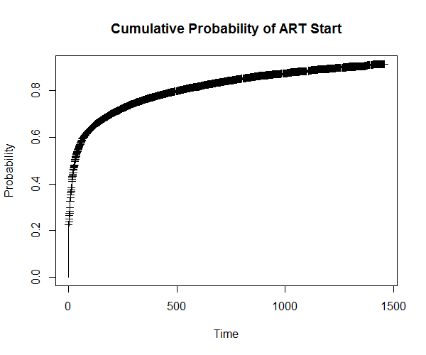
Overall cumulative probability for ART start.

Slide 10
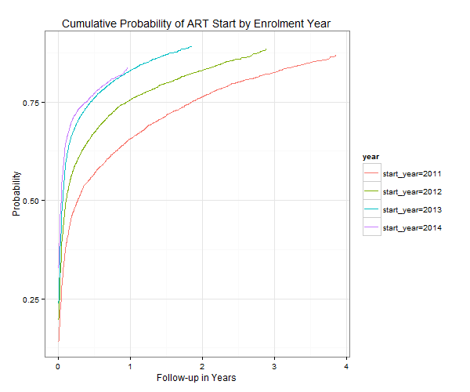
Cumulative probability of ART start by Enrolment Years.

Slide 11
Next steps
Figure out how better to do and report survival analysis (censoring LTUF prior ART start).
Start literature reviews and draft zero for the manuscript.
Propose plans towards manuscript submission.
Think of other analyses (same for adults??)
Propose analysis results package for policy makers at ministry of Health Tanzania.

Slide 12
My Life time event when at McMaster
On Thursday 1st October 2015 at 22:16 EAT (My 5th week at this visit)

Slide 13

My wife Vivianne gave birth to our son Jensen

Slide 14
Thank you all!!

